Slide 1
Maintenance of CBR Systems
Aziz Doumith
CSE 435
November 2nd 2012

Slide 2
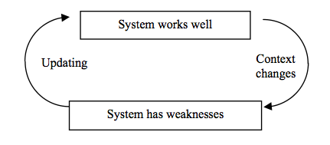
Introduction
Maintenance for technical devices is standard:
Physical objects require maintenance because they are used and each usage lowers their qualities
Software objects require maintenance because their context is changing
In particular, knowledge maintenance
Concerned with:
Corrections: Removing bugs
Improvement of Performance
Adaptation to changed environment and changed knowledge

Slide 3
Overview
Maintenance is the technical top-level process during which the experience management application is maintained.
Sub-processes include:
Monitoring of the Performance
Change Selection
Updating Vocabulary (if necessary)
Updating the Reuse-related Knowledge
Updating the Experience Base
Updating the Similarity Metrics
Updating the Adaptation Knowledge
Test of Aspired Change
Apply Update on Living Application
All operations performed lead to a changed behavior (improved) of the problem solving cycle.

Slide 4
INRECA Methodology
The basic philosophy is the experience based construction of experience management applications
The main focus of the INRECA methodology lies on the modeling of this kind of experience
Experience is represented in the form of structured text documents that are hyper-linked in a special way
Allows for greater flexibility for representing experience

Slide 5
INRECA Experience Base
Organized into three levels of abstraction
Common generic level at the top
Processes, products, and methods are collected that are common for a very large spectrum of different experience management applications.
Cookbook level in the middle
Processes, products, and methods are tailored for a particular class of applications (e.g. help desk, technical maintenance, product catalogue).
For each application class, this contains the recipe.
The recipe describes how an application should be developed and/or maintained
Specific project level at the bottom
Experience described in the context of a single, particular project that has already been carried out.
Project specific information

Slide 6
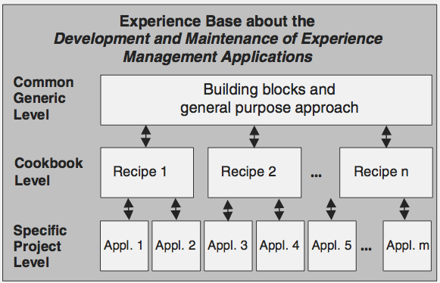
INRECA Experience Base

Slide 7
Maintenance of the INCRECA Experience Base
Analyze Project Trace
Collect all information that has been captured about the finished project
Analyze this information and identify the processes that were actually performed during the enactment of the project.
Add Specific Project
Document the project by creating a specific process description that accurately describes what has been done in the project
Add this process description to the specific project level of the INCRECA experience base

Slide 8
Maintenance of the INCRECA Experience Base
Create or Update Recipe (Optional)
Based on experience collected from the new project, it might become necessary to update an existing recipe or even create an entirely new one.
Updating may be necessary, for example, if the recipe was used to set up a project plan but the experience from enacting the project indicated significant deviations from the plan.
Creating a new recipe may be necessary if the new application was developed that was not covered by any of the existing recipes.
Updating Generic Level (Optional)
If during the previous steps, some new generic processes, methods, or products can be identified that are more general interest (i.e. for more than one application class) then it should be added to the common generic level of the experience base

Slide 9
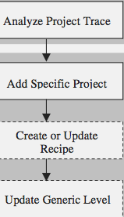
Maintenance of the INCRECA Experience Base

Slide 10
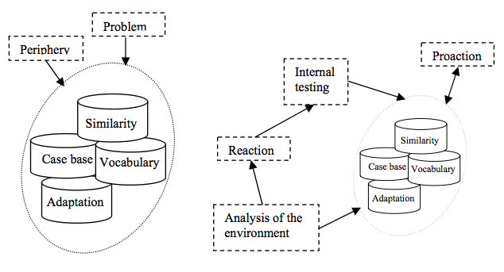
Overview
Three Components:
Internal
External
Peripheral

Slide 11
Changes/Visibility/Actions
Two Categories of Changes:
Corrective Actions
Changes that require immediate revise
Adaptive Actions
Slowly increasing changes
Distinction between Changes:
Visible
Results of observations and messages
Invisible
Small changes of context that may, however, add up
Two Categories of Actions:
Reactions on Demand
Direct complaint or observation
Proactive Reactions
Acting before demand arrives

Slide 12
Actions on Demand
Result from explicit outside information or the discovery of bugs
Provided by the user or internally
Examples:
Changes in resources available
New rules in the company
Discovery of a glitch
Customer complaints
New customers and new business
Main Goal: Provide corrections that ensure systems working correctly
In most situations, immediate action is required
All these reasons for actions are visible.

Slide 13
Pro-action and Internal Testing
Usually result from invisible changes and properties of system and the context
Result in:
Adaptations to small and long term context changes
Making the system “more perfect”
Improve non-functional properties such as:
Efficiency
Interface
Understandability
Due to invisible nature, changes need to be discovered
This is the task of maintenance indicators

Slide 14
Maintenance Indicators
“When and which tests should be performed?”
Indicators can be observed, however, the information they contain is hidden.
The measurements and evaluations make them explicit
Important Maintenance Indicators are:
Insufficient and erroneous solutions
Case utilization statistics
Very frequently retrieved cases may indicate poor coverage
Very infrequently retrieved cases may be redundant
Retrieval time is too long
Poor case base organization
Wrong choice of similarity metric and retrieval method
CBR system changed by methods it has (e.g. removing duplicates)
Creates the need for checking the performance of the new system

Slide 15
Case History
A case history of a case is the sequence of operators that describe what happened to the case
Similar to Steps 1 and 2 of the INCRECA Methodology

Slide 16
Provenance
A provenance record is a set of case histories
Stored in the experience factory
Assigned to a set of cases that share a common history
Use of Provenance Records:
The ultimate origin is the source from which the case is imported
Reliability of the source
The context in which the source was used
Even if case was correct and delivered perfect solutions at a previous time, may no longer be useful
Each source should have a time stamp and goal description
Maintenance Purposes
If some cases need to be changed then history can support this
Can help detect the reasons for weakness
Unreliable sources can be replaced by better ones

Slide 17
Systematic System Maintenance
Maintenance is a part of the overall business process
Hence, it requires a professional organization that has a well-defined structure
The most prominent maintenance operations are concerned with cases and the case base
Maintenance requires some additional techniques outside from the proper CBR system in order to be performed well, such as:
Experience Factory
Change Management
Maintenance Objects
And more!

Slide 18
Experience Factory
An experience factory is a logical and/or physical organization that supports project developments by analyzing and synthesizing all kinds of experiences and methods
Essentially, a general repository of experiences that are useful for system development and maintenance.
Specifically for maintenance, it contains examples and guidelines when and in which ways maintenance operations (including evaluations) should be performed.
In addition, history records of the origins of the cases are very useful for maintenance.
Thus, the experience factory must be constantly updated.

Slide 19
Change Management
Propagation of known changes (environmental and knowledge) to the place where they are used.
Change actions described by operators
These operators are defined on information units (e.g. attributes or cases)
If a change or information unit is reported then the change rules describe the subsequent changes.
The arrival of new information is called an event and the question is who has to be informed about the event
Has consequences on a few parts of the system only
Events and conditions are the preconditions of the rules.
If they are satisfied then the rule takes place.

Slide 20
Event-Condition-Action (ECA)
An ECA rule references an Event, refers to a Condition, and calls an Action.
The actions are subclasses or instances of an Action Class.
The Action Class describes the executable actions.
Example: The notify action
This action notifies some agents about an event and the conditions describe the types of addressed changes.
Example: Changes in the allergy list (document “allergy”) causes a change in the therapy list (document “therapy”).
Event – REPLACE(allergy, therapy, patient, allergy x, allergy y)
Conditions – Patient is in “allergy” and in “therapy”
Action – NOTIFY(responsible(therapy), “event”, allergy of patient, alternatives, allergy manager)

Slide 21
Rules
Rule patterns for actions are defined at compile time
They represent general knowledge about the processes
Instances of rules are generated at run time
Triggered by events
The time of generation of rules is not necessarily identical with the time when they are used
Determined by the event which is part of the precondition of rule
Rules have to be organized in a rule system
A basic structural element is:
An organizational concept E has a change impact on a concept F is a change of E results in a change of F.
E.g. a list describing the contents of a medicine has a change impact on the list describing the doses
Change rules have the special property that they have to be executed necessarily
Rules in general can be executed only if wanted

Slide 22
Maintenance Objects
Maintenance takes place on three levels:
The top level considers the model
Vocabulary
Similarity measure
Rules
Retrieval functions
The intermediate level considers the case instances:
Generate cases
Delete cases
Adapt cases
The lowest level considers the implementation

Slide 23
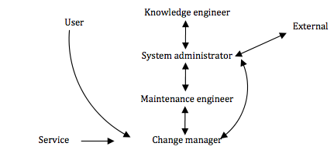
Maintenance Participants
The major participants (agents) in the maintenance task are shown below.
User and service are outside institutions that provides information concerned with the available solutions
Only parts of the environment that can be contacted
The change manager accepts change results and distributes them to the responsible agents

Slide 24
Maintenance Participants
The administrator should take care of a maintenance manual that is associated to the experience factor.
The development of this manual is shown below

Slide 25
Testing and Measurements
Used to detect failures and weaknesses of the system
The change management collects:
Information from service
Information and feedback from users
Information from maintenance engineer about system changes
The change management reports either continuously or at certain time points
The reports can contain information about maintenance indicators such as failures, errors, and poor performance

Slide 26
Information from users vs. service
The information from users and services are very different in nature
The latter changes the underlying model of the CBR system
The results from these reports dive rise to testing and measuring operations.
Should be stored and made accessible in the experience factory.
The service reports on changed objects used for the solution
E.g. available products, methods, techniques etc.
Results in:
Changing a name
Adding, deleting or changing whole objects and their properties.
Needs to be propagated to different containers
Can affect the weights and the similarity metric
Changing the structure of objects
More radical changes
Also reported to different containers

Slide 27
Information from users vs. service
The reports from users, on the other hand, are concerned with the use of the system
Apply to:
CBR system
Report on error, requests, and new requirements
Suggest cases or other changes
Users may notify on poor performance and deficits in the periphery
Users are major sources of information about the behavior of the system

Slide 28
Triggers
Measurements, as well as maintenance actions, need to be triggered in order to determine when they should be performed.
There are three main types of triggering
Event based
Give rise to the application of ECA-rules
Ad hoc
No specific systematic present
Periodically
Fixed time intervals
Relies on experiences that determine in which intervals measurements and maintenance are useful and necessary.

Slide 29
Periphery
The user interface is also subject to maintenance
Generally, changing or updating the periphery does not affect the other parts of the system
But has direct influence on user friendliness.
Maintenance is applied for new user types
For example if the old system was dealing with experts only and the new users are beginners, then they need a new user interface
This is an event based triggering.

Slide 30
Dependencies
For change management, it is important to be aware of dependencies.
This means that if one part is changed, we need to be aware which other parts may be affected and who needs to be informed.

Slide 31
Thank You!
Questions?

